Slide 1

Multi-Mode alu with Interrupt Support

Slide 2
AGENDA
Design Requirements ​
Verification Plan
Environment Architecture
Makefile
Simulation Results on VCS
​Coverage Plan on Verdi
Resources

Slide 3
Design Requirements

Slide 4
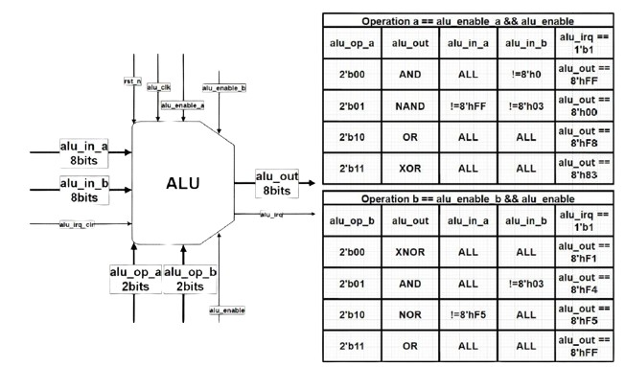
Design Requirements

Slide 5
Design Requirements
ID | Signal | Description
DR1 | alu_clk | Frequency is 32 MHz (31 nanoseconds 1000/32) Positive edge triggered clock.

Slide 6
Design Requirements
ID | Signal | Description
DR2 | rst_n | Active low, asynchronous reset. Whenever rst_n is low, then alu_out and alu_irq should be driven to 0. rst_n should be asserted at least once at start-up.

Slide 7
Design Requirements
ID | Signal | Description
DR3 | alu_in_a | Synchronized to alu_clk, positive edge trigger. When alu_op_a == NAND , alu_enable == 1, alu_enable_a == 1 and alu_enable_b == 0 then alu_in_a can’t take value of 8’hff. When alu_op_b == NOR, alu_enable == 1, alu_enable_a == 0 and alu_enable_b == 1 then alu_in_a can’t take a value of 8’hf5.

Slide 8
Design Requirements
ID | Signal | Description
DR4 | alu_in_b | Synchronized to alu_clk, positive edge trigger. When alu_op_a == AND, alu_enable == 1, alu_enable_a == 1 and alu_enable_b == 0 then alu_in_b can’t take value of 8’h0. When alu_op_a == NAND, alu_enable == 1, alu_enable_a == 1 and alu_enable_b == 0 then alu_in_b can’t take value of 8’h03. When alu_op_a == AND, alu_enable == 1, alu_enable_a == 0 and alu_enable_b == 1 then alu_in_b can’t take value of 8’h03.

Slide 9
Design Requirements
ID | Signal | Description
DR5 | alu_enable | Synchronized to alu_clk, positive edge trigger. If alu_enable is de-asserted: All outputs should be maintained, if rst_n is high, regardless of alu_enable_a or alu_enable_b. If alu_enable is asserted: alu_enable_a and alu_enable_b can’t be asserted at the same time.

Slide 10
Design Requirements
ID | Signal | Description
DR6 | alu_enable_a alu_enable_b | Synchronized to alu_clk, positive edge trigger. When alu_enable is asserted: if alu_enable_a == 0 and alu_enable_b == 0, it is legal and all outputs should be maintained. if alu_enable_a == 0 and alu_enable_b == 1, it is legal and the ALU should do operation b. if alu_enable_a == 1 and alu_enable_b == 0, it is legal and the ALU should do operation a. if alu_enable_a == 1 and alu_enable_b == 1, it is illegal and the output depends on RTL that cover this case. (Note: RTL can have //full case Synopsys so this case will be excluded.)

Slide 11
Design Requirements
ID | Signal | Description
DR7 | alu_op_a | Synchronized to alu_clk, positive edge trigger. When it is 2’b00, alu_out should be the AND-ing of the inputs. When it is 2’b01, alu_out should be the NAND-ing of the inputs. When it is 2’b10, alu_out should be the OR-ing of the inputs. When it is 2’b11, alu_out should be the XOR-ing of the inputs. (Note: The design may don’t have a default case, all cases are covered)

Slide 12
Design Requirements
ID | Signal | Description
DR8 | alu_op_b | Synchronized to alu_clk, positive edge trigger. When it is 2’b00, alu_out should be the XNOR-ing of the inputs. When it is 2’b01, alu_out should be the AND-ing of the inputs. When it is 2’b10, alu_out should be the NOR-ing of the inputs. When it is 2’b11, alu_out should be the OR-ing of the inputs. (Note: The design may don’t have a default case, all cases are covered)

Slide 13
Design Requirements
ID | Signal | Description
DR9 | alu_irq_clr | Synchronized to alu_clk, positive edge trigger. It should be high for at least one clock cycle then it gets de-asserted. It should be high after at least one clock cycle from the assertion of alu_irq. It is an active high clear signal.

Slide 14
Design Requirements
ID | Signal | Description
DR10 | alu_out | Synchronized to alu_clk, positive edge trigger. Should be as expected, according to the given table, after one clock cycle from applying the inputs. If alu_enable and alu_enable_a are asserted, and alu_enable b is de-asserted while alu_op_a is NAND then alu_out never be 8’h00, due to the constrain on alu_in_a.

Slide 15
Design Requirements
ID | Signal | Description
DR11 | alu_irq | Synchronized to alu_clk, positive edge trigger. It should be asserted after one clock cycle from the event that triggers it. Events that assert it to high, in case of other events alu_irq maintains its value.

Slide 16
Design Requirements
ID | Signal | Description
DR11 | alu_irq | When alu_enable && alu_enable_a && !alu_enable b, operation a: If alu_op_a is AND, alu_in_a is 8’hFF and alu_in_b is 8’hFF. If alu_op_a is NAND and ~(in_a & in b) equals 8’h00. (Note: this case can’t happen) If alu_op_a is OR and (alu_in_a | alu_in_b) equals 8’hE8. If alu_op_a is XOR and (alu_in_a ^ alu_in_b) equals 8’h83.

Slide 17
Design Requirements
ID | Signal | Description
DR11 | alu_irq | When alu_enable && alu_enable_b && !alu_enable a, operation b: If alu_op_b is XNOR and (alu_in_a ~^ alu_in_b ) equals 8’hF1. If alu_op_b is AND and (alu_in_a & alu_in b) equals 8’hF4. If alu_op_b is NOR and ~(alu_in_a | alu_in_b) equals 8’hF5. If alu_op_b is OR and (alu_in_a | alu_in_b) equals 8’hFF.

Slide 18
Design Requirements
ID | Signal | Description
DR11 | alu_irq | It should be high until alu_irq_clr is asserted. It should be de-asserted after one clock cycle from asserting alu_irq_clr. Event has a priority over alu_irq_clr, when there is an event from the previous ones and alu_irq_clr is asserted at that time, then alu_irq should be high.

Slide 19
Verification Plan

Slide 20
Verification Plan
ID | Signal | Description
VR1 | alu_clk | Driven positive edge trigger clock with a period of 31.25 ns, (1000/32MHz). (Note: timescale 1ns/1ps)

Slide 21
Verification Plan
ID | Signal | Description
VR2 | rst_n | Drive it with 0 at the start, then it can be 0 or 1 at different times during normal operation independent of the clock, most of the time it is high. Cover that reset is de-asserted and asserted. Check that outputs are driven to all 0’s immediately when it is low. Check that outputs are as expected when it is high.

Slide 22
Verification Plan
ID | Signal | Description
VR3 | alu_in_a | Driven constrained randomly. Cover that the forbidden values aren’t generated. Cover that all input pins toggle from 1 to 0 and vice versa.

Slide 23
Verification Plan
ID | Signal | Description
VR4 | alu_in_b | Driven constrained randomly. Cover that the forbidden values are not generated. Cover that all input pins toggle from 1 to 0 and vice versa.

Slide 24
Verification Plan
ID | Signal | Description
VR5 | alu_enable | Drive it with 1 or 0, most of the time it is high. Cover that alu_enable, alu_enable_a and alu_enable_b toggle from 1 to 0 and vice versa Check that all outputs are maintained when alu_enable is low.

Slide 25
Verification Plan
ID | Signal | Description
VR6 | alu_enable_a | Drive it with 1 or 0, most of the time alu_enable_a dosen’t equal alu_enable_b. Cover that alu_enable_a toggles with all variations of alu_enable. Check that when alu_enable_a is high, alu_out is generated according to operation a.

Slide 26
Verification Plan
ID | Signal | Description
VR7 | alu_enable_b | Drive it with 1 or 0, most of the time alu_enable_a dosen’t equal alu_enable_b. Cover that alu_enable_b toggles with all variations of alu_enable. Check that when alu_enable_b is high, alu_out is generated according to operation b

Slide 27
Verification Plan
ID | Signal | Description
VR7 | alu_op_a | Driven with all possible combinations randomly. Cover all possible combinations while alu_enable and alu_enable_a are high, and cover all other possible cases, listed in design requirements. Check that when the operation is NAND while alu_enable and alu_enable_a are asserted to high, alu_out will never be 8’h00.

Slide 28
Verification Plan
ID | Signal | Description
VR8 | alu_op_b | Driven with all possible combinations randomly. Cover all possible combinations while alu_enable and alu_enable_b are high, and cover all other possible cases, listed in design requirements.

Slide 29
Verification Plan
ID | Signal | Description
VR9 | alu_irq_clr | Drive it with 1 while alu_irq is de-asserted. Cover alu_irq_clr that is asserted and alu_irq is de-asserted. Check if alu_irq is still 0 or not. Drive it with 1 after alu_irq is asserted. Cover that alu_irq_clr is asserted and alu_irq is also asserted. Check that alu_irq is cleared, equals 0. Drive it with 0 regardless of the value of alu_irq, 1 or 0. Cover that alu_irq_clr is low when alu_irq is asserted and de-asserted at different times. Check that alu_irq is maintained.

Slide 30
Verification Plan
ID | Signal | Description
VR10 | alu_out | Cover that all alu_out combinations that asserts alu_irq are generated. Cover that alu_out pins toggles. Check that alu_out is asserted after one clock cycle from applying the inputs. Check that alu_out is maintained when alu_enable_a and alu_enable_b are asserted to low at the same time.

Slide 31
Verification Plan
ID | Signal | Description
VR11 | alu_irq | Check that alu_irq is asserted to high at the same cycle as alu_out. Check that alu_irq isn’t asserted unless alu_out is one of the cases listed in the design requirements. Drive alu_irq_clr to high while there are two successive events that assert alu_irq.

Slide 32
Verification Plan
ID | Signal | Description
VR11 | alu_irq | Cover that alu_irq_clr is asserted while there is two successive events that assert alu_irq. Check that events have priority over alu_irq_clr Check that alu_irq is low when alu_irq_clr high, taking into consideration that there isn’t two successive events. Check that alu_irq is still asserted when there is two successive events while alu_irq_clr is high. Check that alu_irq is de-asserted after one clock cycle from the assertion of alu_irq_clr.

Slide 33
Environment Architecture

Slide 34
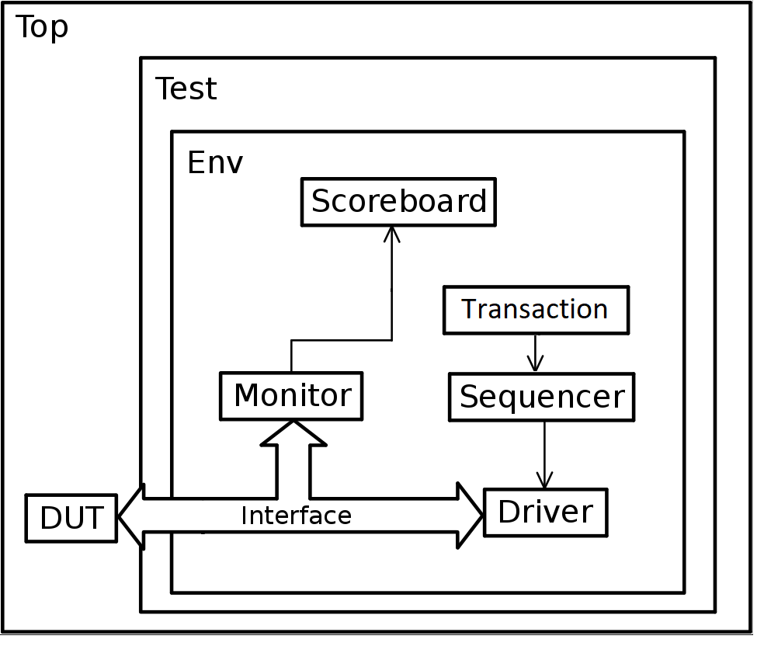
Environment Architecture
Black box

Slide 35
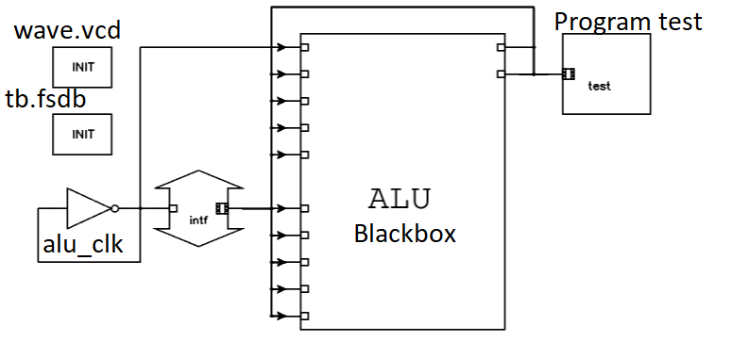
Environment Architecture

Slide 36
Makefile

Slide 37
Makefile
#--------------------------------------------
comp : clean vcs coverage_html cov_verdi
#---------------------------------------------
vcs :
vcs \
-f files.f -cm line+fsm+tgl+branch+cond \
-timescale=1ns/1ps +vcs+flush+all \
-fsdb -full64 -R +vc +v2k -sverilog -debug_all \
-gui -l vcs_out.log &
#---------------------------------------
verdi :
verdi -f files.f -ssf -sv tb.fsdb &
#---------------------------------
coverage_text :
urg -dir simv.vdb -format text &
#-------------------------------
coverage_html :
urg -dir simv.vdb &
#----------------------------------
cov_verdi :
verdi -cov -covdir simv.vdb &
#----------------------------------------
clean :
rm -rf *~ core csrc simv* vc_hdrs.h ucli.key urg* *.log novas.* *.fsdb* &
#------------------------------------

Slide 38
Simulation Results on VCS

Slide 39
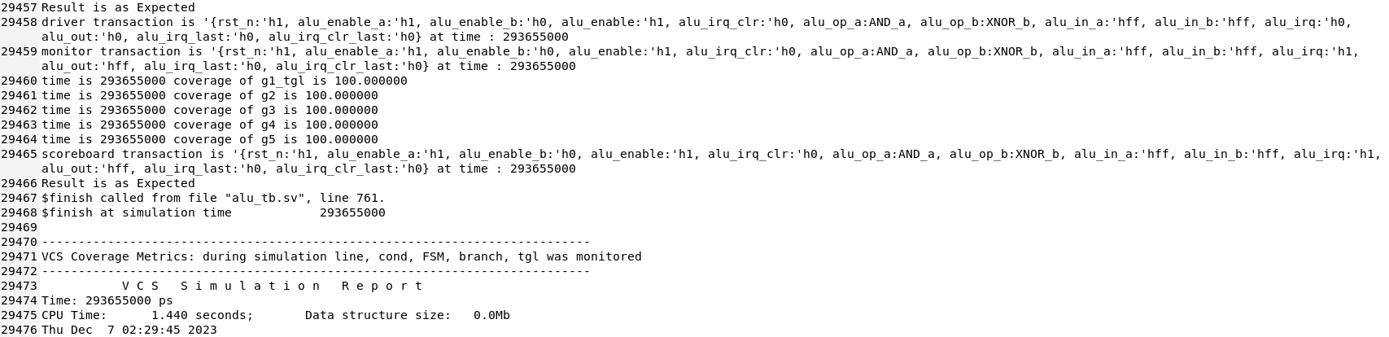
Simulation Results on VCS

Slide 40
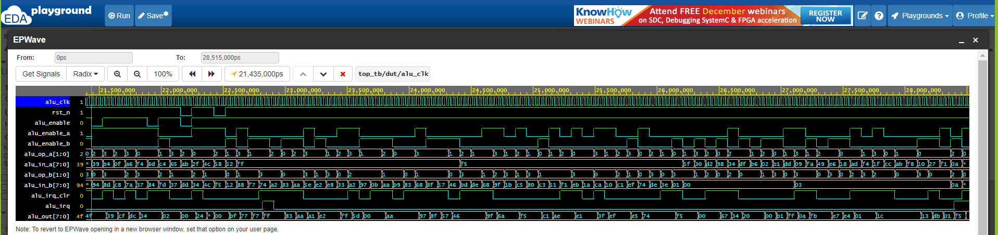
Simulation Results on VCS

Slide 41
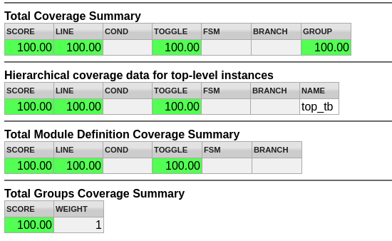
Simulation Results on VCS

Slide 42
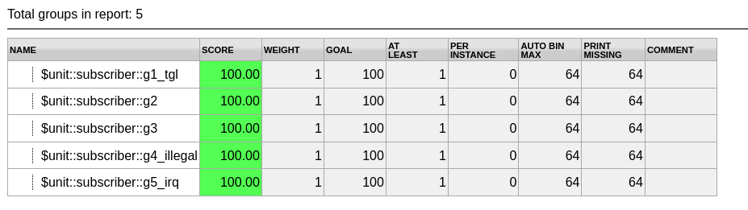
Simulation Results on VCS

Slide 43
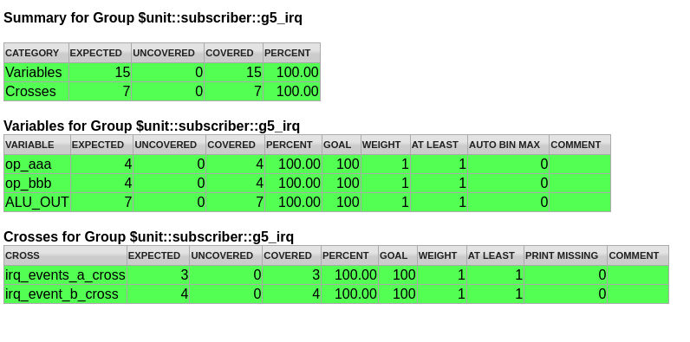
Simulation Results on VCS

Slide 44
Coverage Plan on Verdi

Slide 45
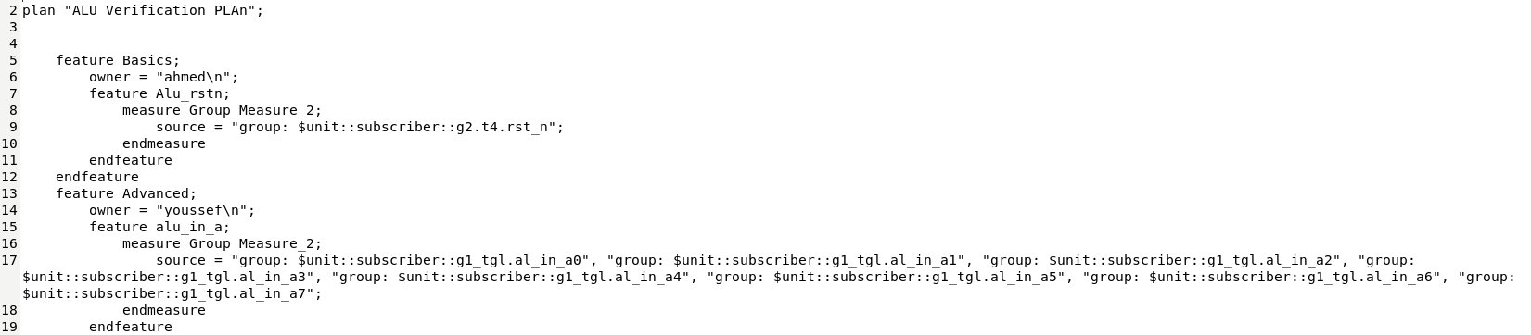
Coverage Plan on Verdi

Slide 46
Resources

Slide 47
Resources
https://edaplayground.com/x/pgqd
https://drive.google.com/drive/folders/1J8qK3HRA0X3-30uCedGeiX85ineHsu5D?usp=sharing

Slide 48
THANK YOU

